Slide 1
Problem Identification
[
]
How can we optimize ticket values and facilities so that our profit margin increases, despite the steep increase in operating costs this season?
We are seeking to understand:
Which facilities our customers prioritize
How we can use market data around ski resort ticket prices in the nation and in our region to optimize ticket prices
How to offset our increase in operating costs and hopefully increase our profit margins as well

Slide 2
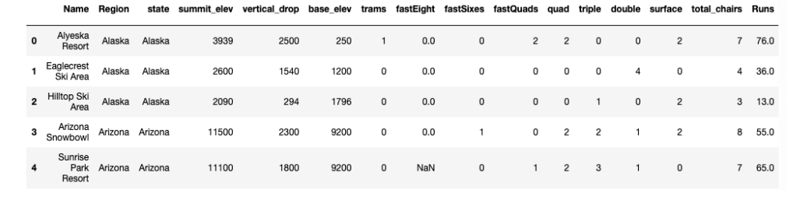
Key Findings
Data Callouts
Conducted market research and collected data on ski resorts (consisting of a count and measure of their amenities as well as prices) across the nation
Based on the information gathered, we decided to focus on the price of Adult Weekend ticket prices, though it can be noted that several resorts had different tiers and prices for different types of tickets.
Data snippet below:

Slide 3
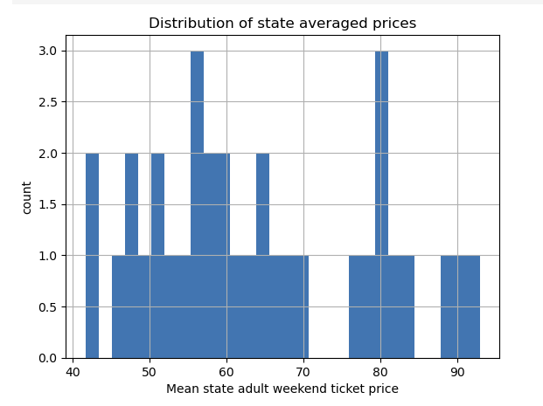
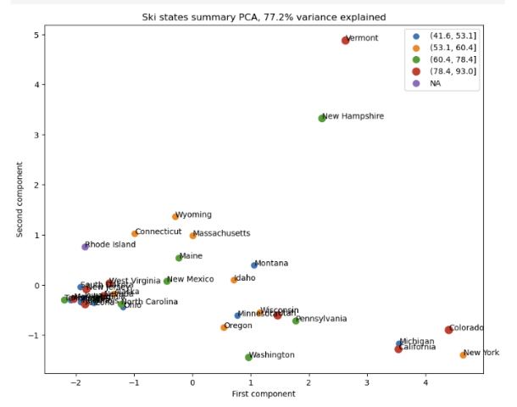
Key Findings
There is no specific distribution or pattern in the mean adult weekend ticket prices by state that we could see based on the count of ticket prices
In general, there did not seem to be a pattern of any sort when we looked at mean ticket prices by state

Slide 4
Model Analysis
Model Process
We created two models—a linear regression and a random forest model—to predict a ticket price based on specific amenities
We trained and tested the model on the data we had previously collected on other resorts, excluding Big Mountain’s data
After assessing both models, the Random Forest Model was more accurate and precise, with a smaller error range and less variability
Dominant Four Features
fastQuads: Number of fast four person chairs
Runs: Count of number of runs on the resort
Snow Making_ac: Total area covered by snow making machines in acres
vertical_drop: Vertical change in elevation from summit to base in feet

Slide 5
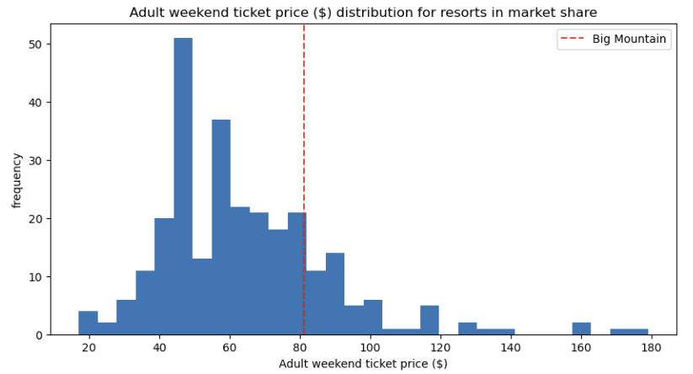
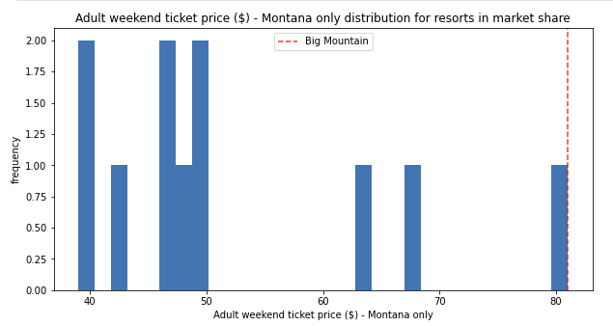
Ticket Price Analysis
Current Ticket Price: $81
Modeled Ticket Price: $95.87
Error Range: $85 - $106
]
We can see that Big Mountain is on the higher end of price tickets in the nation and at the very highest end for Montana ski resorts

Slide 6
Conclusion
Recommendation
Increase ticket prices by an additional $.88 to cover the operating cost of the new lift
or
Find ways to further decrease operating costs
Risks
Our model is missing key pieces of data that would better help us understand not only revenue, but also profit. These missing pieces of data include, but are not limited to:
Operating costs/Profit margins
Utilization per amenity
Competitors’ visitor/customer numbers
The modeled price was higher than our current price, which could be due to several reasons we should consider:
Market demand—customers may not be willing to pay much higher for a ski resort ticket
Competitors could be severely underpricing or overpricing their tickets
Our # of amenities does not provide insight on the quality of our amenities
Our ticket prices are already at the higher end of the range of ticket prices, both in Montana and nationally

Slide 7
Next Steps
Collect Missing Data
Build Out a Profit Optimization Model
Identify Amenities to Shut Down or Improve
Begin Rollout Strategizing
Collect missing data (as specified in conclusion slide) and conduct data cleaning and data analysis
Use new data to improve our current ticket prediction model and incorporate this model into a profit optimization model that will predict the best ticket price to improve profit margins when operating costs are taken into account
Run various scenarios in our model to see which amenities are most beneficial to improve and build upon and which we could shut down to decrease operating costs
Begin considering how to strategize and implement the rollout of changes

